Slide 1



AI : Customer Segmentation Using Unsupervised Learning
By : Nancy Gupta, Piyush Jain, Samay Verma

Slide 2

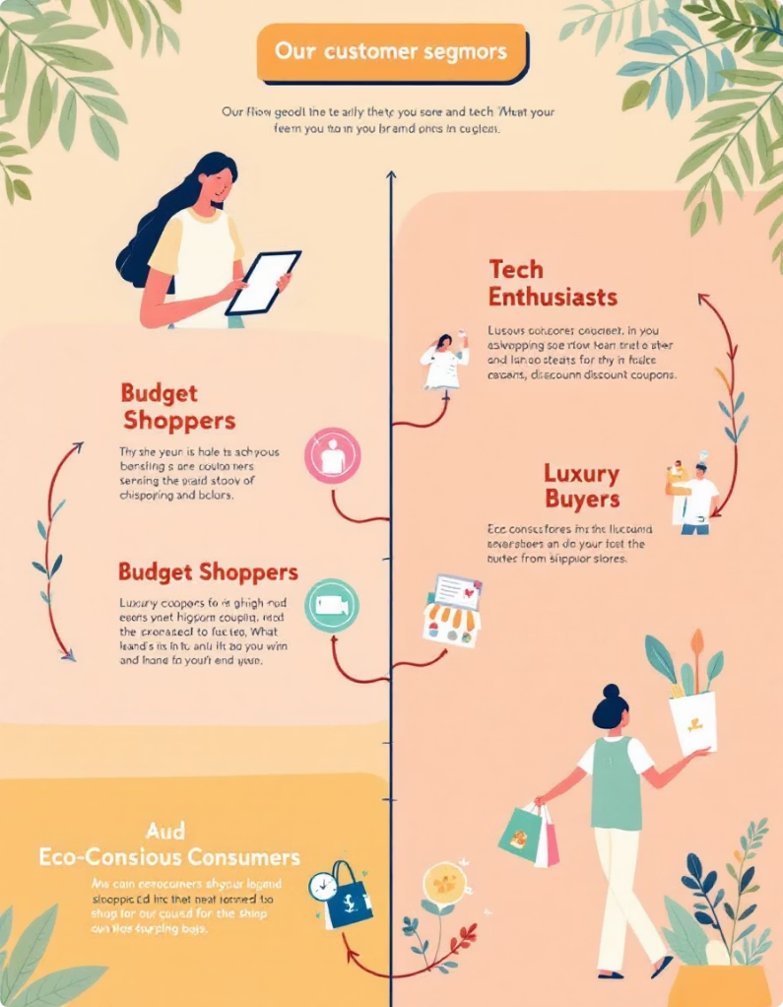
What is Customer Segmentation?
Definition
Divide customers by shared traits
Purpose
Improve marketing and resource use
Examples
Demographics
Behavior
Purchase history
Psychographics
Methods
Traditional vs. data-driven

Slide 3
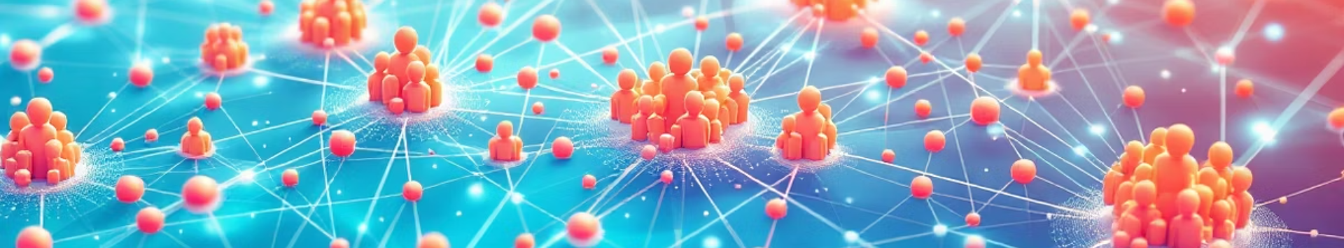




Why Use Unsupervised Learning?
Discover Hidden Patterns
No Pre-defined Labels
Find unknown customer segments
Adapts automatically to data
Reduces Bias
Handles Large Datasets
Less reliance on preset rules
Efficient processing and clustering

Slide 4

Unsupervised Learning Algorithms for Segmentation
K-Means Clustering
Hierarchical Clustering
DBSCAN
Group data into K clusters by distance
Build tree of clusters with levels
Identify clusters based on density
Example: Cluster by spending habits
Example: Visualize segments granularity
Example: Detect outliers and niches

Slide 5

Data Preprocessing
Data Collection
Use transactions, demographics, and activity
Feature Selection
Choose purchase frequency, order value, recency
Data Cleaning
Handle missing values and outliers
Feature Scaling
Normalize data to avoid bias

Slide 6

Implementation and Tools
Languages
Libraries
Cloud Platforms
Example
Python
scikit-learn
AWS
Python K-Means code snippet
pandas
Google Cloud
matplotlib, seaborn
Azure

Slide 7
Case Study: E-commerce Customer Segmentation
Dataset
Features
Algorithm
Segments
Online retail transaction data
Frequency, recency, monetary value
K-Means, K=3
High-Value
Mid-Value
Low-Value

Slide 8

Conclusion
Key Takeaways
Next Steps
Unsupervised learning powers segmentation
Explore advanced algorithms, add new data sources
Data prep and algorithm choice crucial
Insights boost marketing ROI

Slide 9


